Slide 1
from Jam import Paydavousi
NameError: name ‘Jam' is not defined
from Paydavousi import Jam

Slide 2
What’s Up?
What is the project about?
How is it built and how does it work?
What is next?

Slide 3

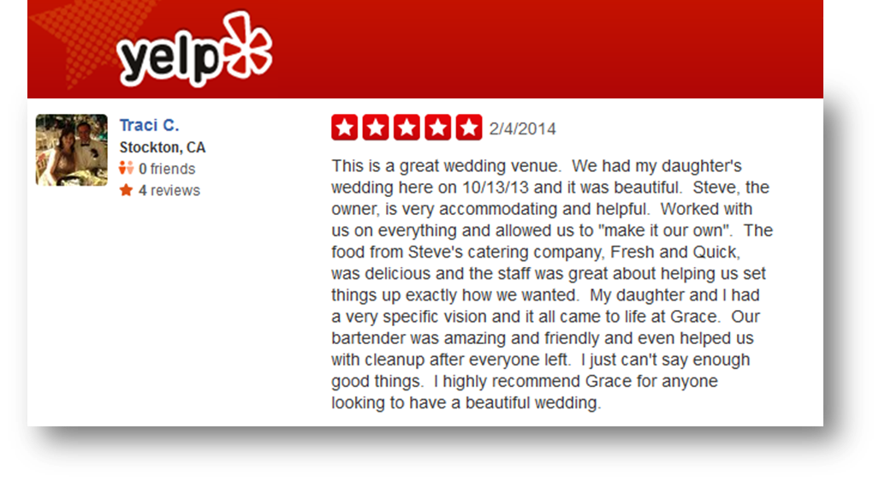
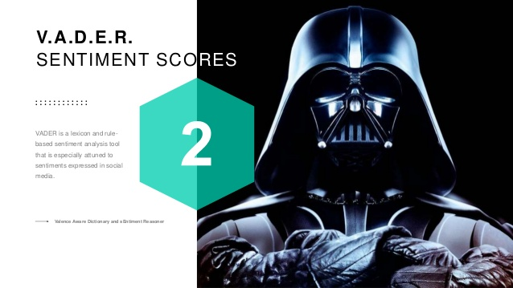
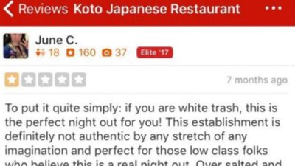
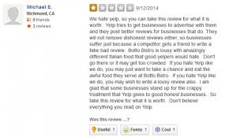
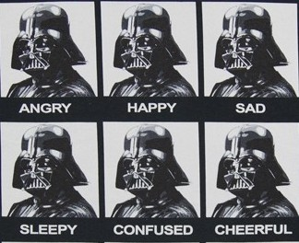
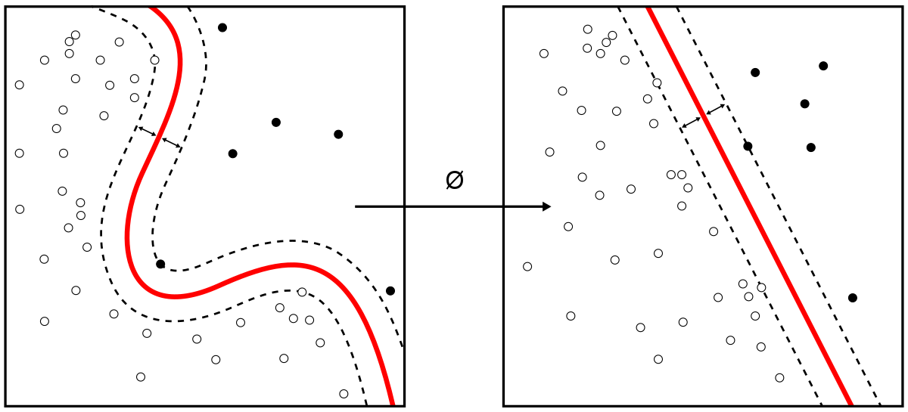
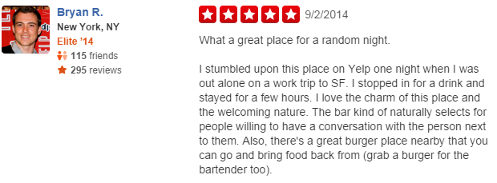
What is the project about ?
Naïve Bayes
Machine Learning
Natural Language Processing
1
3
4
Tokenization
Stop Words Filtering
TF-IDF

Slide 4
What is the project about ?
Provide merchants with quantified classification summary of Yelp results by using Machine Learning – Natural Language Processing.
Capture Yelp reviews of a restaurant.
Use Vader Sentiment Analyzer (VSA) to provide baseline for measuring effectiveness of machine learning.
Utilize Data Processing Pipeline to transform and clean the data for ML.
Use Naïve Bayes model to classify reviews as ‘positive’ (0) or ‘negative’ (1) and compare results to ‘Class’ as calculated by VSA.

Slide 5










How does it work ?
Naïve Bayes
Naïve Bayes

Slide 6
Let’s run the software

Slide 7
Example 1:
I don't write many One Star reviews, so when I do, they are well deserved.Look at the owner's response. What a joke like the food and service.Small portionsOverpriced and lousy service!!!!!ATJAAC - Avoid This Joint At All Costs!!!!!
I don't write many One Star reviews, so when I do, they are well deserved.Look at the owner's response. What a joke like the food and service.Small portionsOverpriced and lousy service!!!!!ATJAAC - Avoid This Joint At All Costs!!!!!
Vader Sentiment Analysis: ‘Positive’

Slide 8
Example 2:
Agree with Daniel Z.'s review revealing that they are *very* deceitful. It just gives me a bad feeling about the ownership and I prefer to support businesses that are ethical, honest, and customer-oriented rather than ones that engage in tactics to be sneaky about nickel-and-diming or price gouging customers. Makes me wonder what shortcuts they are taking with food/ingredients to penny pinch. I ordered a gyro wrap, and it came complete with surprise extra charges for offered sauces and fries which were pictured on the menu *with* the wrap and the listed price for a wrap; and, when I ordered, he simply said, "fries ok for the wrap?" instead of asking me, "Do you want to add fries for $4" or whatever. He also offered me the choice of a sauce from a list of I believe 3, never letting me know that it'd be another couple of extra dollars if I made a selection lol. Ended up doubling what I thought I was paying for a quick lunch, and I didn't really enjoy the meal itself. Beware guys--I won't be back.
Agree with Daniel Z.'s review revealing that they are *very* deceitful. It just gives me a bad feeling about the ownership and I prefer to support businesses that are ethical, honest, and customer-oriented rather than ones that engage in tactics to be sneaky about nickel-and-diming or price gouging customers. Makes me wonder what shortcuts they are taking with food/ingredients to penny pinch. I ordered a gyro wrap, and it came complete with surprise extra charges for offered sauces and fries which were pictured on the menu *with* the wrap and the listed price for a wrap; and, when I ordered, he simply said, "fries ok for the wrap?" instead of asking me, "Do you want to add fries for $4" or whatever. He also offered me the choice of a sauce from a list of I believe 3, never letting me know that it'd be another couple of extra dollars if I made a selection lol. Ended up doubling what I thought I was paying for a quick lunch, and I didn't really enjoy the meal itself. Beware guys--I won't be back.
Vader Sentiment Analysis: ‘Positive’

Slide 9
Example 3:
My husband found this place on Yelp and the pics of the food looked amazing. It did not disappoint! Excellent food! Excellent service! Even my picky daughter devoured the chicken, rice and pita!
My husband found this place on Yelp and the pics of the food looked amazing. It did not disappoint! Excellent food! Excellent service! Even my picky daughter devoured the chicken, rice and pita!
Vader Sentiment Analysis: ‘Negative’

Slide 10
Example 4:
Chicken kebab wrap! The staff is so nice and friendly but the food was a-okay. I got the wrap and ate it only 5 minutes after I received it. However, it was incredibly soggy already as the juices from the meat had permeated the wrapping. At the end, I was eating a bite of the wrap with a fork while trying to get pieces of meat and tomato with my hands. Everything was torn up and dripping. It's not necessarily their fault but I've never had this problem with any other wraps. The plates are a lot more filling and come with a lot of food! You would not run into the problem I ran into with the plates, but insofar as I ate the wrap, I have nothing more to say!
Chicken kebab wrap! The staff is so nice and friendly but the food was a-okay. I got the wrap and ate it only 5 minutes after I received it. However, it was incredibly soggy already as the juices from the meat had permeated the wrapping. At the end, I was eating a bite of the wrap with a fork while trying to get pieces of meat and tomato with my hands. Everything was torn up and dripping. It's not necessarily their fault but I've never had this problem with any other wraps. The plates are a lot more filling and come with a lot of food! You would not run into the problem I ran into with the plates, but insofar as I ate the wrap, I have nothing more to say!
Vader Sentiment Analysis: ‘Negative’

Slide 11

Summary of findings

Slide 12
First Data Processing Pipeline
Tokenizing
Stop Words Filters
TF-IDF

Slide 13
Added more Stop Word Filtering
I love Mediterranean food! I look for healthy food alternatives and know I'll find something at a Mediterranean food restaurant. I choose their greek salad with chicken kabob. This was a perfect blend of flavors starting with their pita bread and green sauce. The salad was so fresh and the balsamic dressing was perfect! THe chicken kabob was wonderfully seasoned and grilled to perfection. I definitely recommend you give this place a try!
Strings that match menu items do not get added to the Stop Words Filter
I am not big on Mediterranean food but this place was delicious and prove to me that Mediterranean foods don't have to be bland. It's a bit pricey but worth it the guy at the desk was super attentive and helpful even when the waiter mixed up our plates with somebody else's he fixed it right away. I can only assume it's the owner as a worker wouldn't care that much

Slide 14
Second Data Processing Pipeline
Tokenizing
Stop Words Filters
TF-IDF
Custom Stop Words

Slide 15
Introduced 2 layers of N-Grams
After stop words
Stopped
Coming
Here
While
Back
Poor
Service
Stopped
Coming
Here
While
Back
Poor
Service
Stopped
Coming
Here
While
Back
Poor
Service
Stopped
Coming
Here
While
Back
Poor
Service
Stopped
Coming
Here
While
Back
Poor
Service

Slide 16
Third Data Processing Pipeline
Tokenizing
Stop Words Filters
TF-IDF
Custom Stop Words
N-GRAM

Slide 17
Introduced 2 layers of N-Grams
Before stop words
The
food
is
terrible
and
way
over
price
The
food
is
terrible
and
way
over
price
The
food
is
terrible
and
way
over
price
The
food
is
terrible
and
way
over
price

Slide 18
Fourth Data Processing Pipeline
Tokenizing
Stop Words Filters
TF-IDF
Custom Stop Words
N-GRAM
N-GRAM

Slide 19
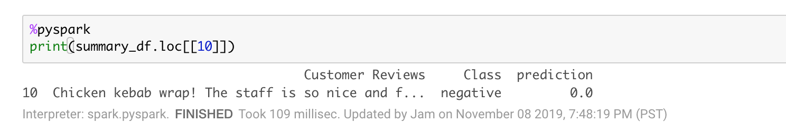
Example 4:
Chicken kebab wrap! The staff is so nice and friendly but the food was a-okay. I got the wrap and ate it only 5 minutes after I received it. However, it was incredibly soggy already as the juices from the meat had permeated the wrapping. At the end, I was eating a bite of the wrap with a fork while trying to get pieces of meat and tomato with my hands. Everything was torn up and dripping. It's not necessarily their fault but I've never had this problem with any other wraps. The plates are a lot more filling and come with a lot of food! You would not run into the problem I ran into with the plates, but insofar as I ate the wrap, I have nothing more to say!

Slide 20
Example 4:
Chicken kebab wrap! The staff is so nice and friendly but the food was a-okay. I got the wrap and ate it only 5 minutes after I received it. However, it was incredibly soggy already as the juices from the meat had permeated the wrapping. At the end, I was eating a bite of the wrap with a fork while trying to get pieces of meat and tomato with my hands. Everything was torn up and dripping. It's not necessarily their fault but I've never had this problem with any other wraps. The plates are a lot more filling and come with a lot of food! You would not run into the problem I ran into with the plates, but insofar as I ate the wrap, I have nothing more to say!
Chicken kebab wrap! The staff is so nice and friendly but the food was a-okay. I got the wrap and ate it only 5 minutes after I received it. However, it was incredibly soggy already as the juices from the meat had permeated the wrapping. At the end, I was eating a bite of the wrap with a fork while trying to get pieces of meat and tomato with my hands. Everything was torn up and dripping. It's not necessarily their fault but I've never had this problem with any other wraps. The plates are a lot more filling and come with a lot of food! You would not run into the problem I ran into with the plates, but insofar as I ate the wrap, I have nothing more to say!
Vader Sentiment Analysis: ‘Negative’
Prediction: ‘Positive’

Slide 21

Where Vader was right!
Horrible communication with I phoned in the order togo with a lady. ����There was definitely a language barrier. ����I asked for a salmon platter family size for 3-5 people $43 and also confirmed over the phone. ����She said yes. ����Then when I picked up my order she charged me over $61 vs $43. ����She said I order the 5-7 people one which was not accurate. ����Worst experience ever. ����She was not friend at all. ����My first and last time going there. ����I should have not purchased and walked away. ����I was ripped off. ����I will not be returning. ����The amount of salmon I was given was very small. ����It would not have feed more then 4 people. ����The food was mediocre. ����I was very disappointed.
negative
0.0
I ordered a gyro and it wasn't very good. The tzatziki sauce had an off flavor which ruined the whole thing. The meat was okay but I thought it was lame that they just put a crappy looking piece of iceberg lettuce in it. There are plenty of other places where you can get a much better gyro.
negative
0.0

Slide 22
Who is right?
Food was delicious. I got a sampler platter, pictured here. My only complaints, and my only reasons for not giving five stars, are as follows. One, this is not a bargain place, as the humble promises may suggest. Even if you assume that this platter will serve two people, you were still talking $10 per person for a walk up /counter service restaurant. Two, as many others have pointed out, you really must order ahead if you want to avoid waiting 20 to 25 minutes at lunchtime. I ordered online 15 minutes before getting to the store, and I still had to wait 10 more minutes after getting there. Not really a negative if you are aware of the issue, but I could see newcomers being put off by it.Three, the amount of pita bread given out as part of the $20 platter is ridiculously small. It's essentially one small circle of pita bread cut into quarters. Sure, they offer additional pita bread, but it is four dollars per order. Nickel and diming. But to reiterate: the food is awesome, fresh, hot and delicious.
negative
0.0
Food was delicious. I got a sampler platter, pictured here. My only complaints, and my only reasons for not giving five stars, are as follows. One, this is not a bargain place, as the humble promises may suggest. Even if you assume that this platter will serve two people, you were still talking $10 per person for a walk up /counter service restaurant. Two, as many others have pointed out, you really must order ahead if you want to avoid waiting 20 to 25 minutes at lunchtime. I ordered online 15 minutes before getting to the store, and I still had to wait 10 more minutes after getting there. Not really a negative if you are aware of the issue, but I could see newcomers being put off by it.Three, the amount of pita bread given out as part of the $20 platter is ridiculously small. It's essentially one small circle of pita bread cut into quarters. Sure, they offer additional pita bread, but it is four dollars per order. Nickel and diming. But to reiterate: the food is awesome, fresh, hot and delicious.
negative
0.0

Slide 23
What is Next ?
Enhance the data
Investigate the False Positives!
Clean up datasets further – update or modify encoding
Add ‘non recommended’ Yelp reviews to the dataset

Slide 24
What is Next ?
II. Enhance the Architecture:
Automate the process for generating Stop Words using the attributes of the merchant: create a list with Python
Quantify favorite dishes and dislikes and add to the report and the NLP model as a feature. I.e.
Run Vader Sentiment Analyzer on the tokenized data to improve baseline and score.
Consider using deep learning for classification, if the score does not improve

Slide 25
What is Next ?
III. Enhance the Architecture:
Put all scripts in one Python app
Create a full stack application, run it on Heroku
Migrate Full Stack to Cloud, using Google CoLabs, AWS, PostgreSQL

Slide 26
What is Next ?
IV. Make it pretty, and Launch for customers:
Provide clients with additional benefit of working with Mobile Ties – no charge
Apply CSS and JAVASCRIPT components to the application.
Use it as a marketing tool to get more prospects and convert them to customers

Slide 27
Questions?

Slide 28


